Slide 1
Factors affect engagement and satisfaction of employees in the Federal workforce

Slide 2
Content
Introduction
Purpose
Dataset
Data Analysis
Data Modeling
Analysis Results
Future Work

Slide 3
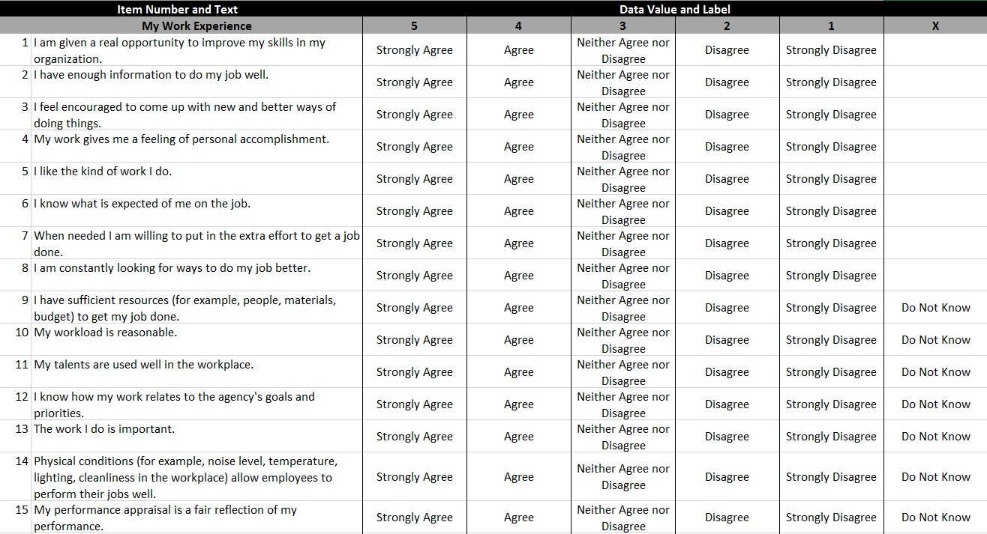
Introduction
Notes:
In 2015, more than 400,000 employees participated in the Federal Employee Viewpoint Survey (FEVS). The survey includes questions about satisfaction, leadership, and work schedules.

Slide 4
Introduction
In this study, I want to solve following problems:
How to measure satisfaction and engagement of employees with answers of survey?
What are the relationships of satisfaction/engagement via different groups (gender, age, years of service, supervisor status, agency etc.)?
What factors affect satisfaction of employees?
What factors affect engagement of employees?
How to drive engagement of employees?
Notes:
The analysis try to identify the working status and give result on in which respect and how to improve the feelings of federal employees.
Employee feedback on key performance metrics captured in the FEVS is singularly important for each agency to realize its mission, as well as maintain and enhance Federal workforce. The feedback enables each agency to develop effective strategies and tools for driving continuous improvement.

Slide 5
Purpose
Analyze the data of the Federal Employee Viewpoint Survey (FEVS).
Identify the working status of federal employees.
Give results on how to improve the feelings of federal employees.
Provide information for agency leaders and managers seek to improve their human capital management.
Guided by the analysis results, agency leaders can take steps to improve how employees engage with their jobs, organizations, and missions.
Notes:
Each year leaders in the Federal Government use the Federal Employee Viewpoint Survey (FEVS) as a management tool to drive change and increase employee engagement in the federal workforce. The use of that data continues to translate into better service for the American people.

Slide 6
Dataset
The survey questions are designed to get feedbacks on the three main indices:
Engagement Index
Global Satisfaction Index
The New IQ Index
Notes:
This project use the annual survey of the Office of Personnel Management. The dataset is in a CSV file and include 84 questions about Work Experience, Work Unit, Agency, Satisfaction, Work/Life balance and so on. It also gives demographics information like gender, age, supervisor status, years in the Federal Government, about to leave or retire, work unit and so on.

Slide 7
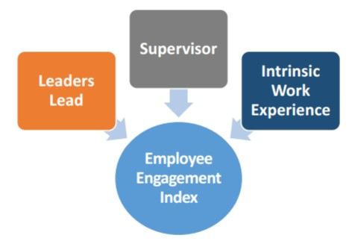
Engagement Index
Employee engagement is the employee’s sense of purpose.
It is evident in their display of dedication, persistence, and effort in their work or overall commitment to their organization and its mission.
Notes:
An agency that engages its employees ensures a work environment where each employee can reach his or her potential, while contributing to the success of the agency. Individual agency performance contributes to success for the entire Federal Government. The index is made up of three sub-factors: Leaders Lead, Supervisors, and Intrinsic Work Experience. Each sub-factor reflects a different aspect of an engaging work environment.

Slide 8
Engagement Index
Leaders Lead reflects the employees’ perceptions of the integrity of leadership, as well as leadership behaviors such as communication and workforce motivation.
Supervisors reflects the interpersonal relationship between worker and supervisor, including trust, respect and support.
Intrinsic Work Experience reflects the employees’ feelings of motivation and competency relating to their role in the workplace.
Notes:
Leaders Lead reflects the employees’ perceptions of the integrity of leadership, as well as leadership behaviors such as communication and workforce motivation. It is made up of the following survey items:
In my organization, senior leaders generate high levels of motivation and commitment in the workforce. (Q. 53)
My organization’s senior leaders maintain high standards of honesty and integrity. (Q. 54)
Managers communicate the goals and priorities of the organization. (Q. 56)
Overall, how good a job do you feel is being done by the manager directly above your immediate supervisor? (Q. 60)
I have a high level of respect for my organization’s senior leaders. (Q. 61)
Supervisors reflects the interpersonal relationship between worker and supervisor, including trust, respect and support. It is made up of the following survey items:
Supervisors in my work unit support employee development. (Q. 47)
My supervisor listens to what I have to say. (Q. 48)
My supervisor treats me with respect. (Q. 49)
I have trust and confidence in my supervisor. (Q. 51)
Overall, how good a job do you feel is being done by your immediate supervisor? (Q. 52)
Intrinsic Work Experience reflects the employees’ feelings of motivation and competency relating to their role in the workplace. It is made up of the following survey items:
I feel encouraged to come up with new and better ways of doing things. (Q. 3)
My work gives me a feeling of personal accomplishment. (Q. 4)
I know what is expected of me on the job. (Q. 6)
My talents are used well in the workplace. (Q. 11)
I know how my work relates to the agency’s goals and priorities. (Q. 12)

Slide 9
Global Satisfaction Index
The Global Satisfaction Index measures employee satisfaction about four aspects related to their work: their job, their pay, their organization, and whether they would recommend their organization as a good place to work.
Satisfied employees are more likely to stay in their jobs, reducing turnover.
Notes:
The Global Satisfaction Index is comprised of the following survey items:
I recommend my organization as a good place to work. (Q. 40)
Considering everything, how satisfied are you with your job? (Q. 69)
Considering everything, how satisfied are you with your pay? (Q. 70)
Considering everything, how satisfied are you with your organization? (Q. 71)

Slide 10
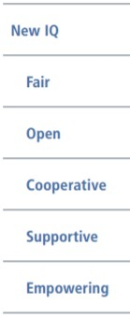
The New IQ Index
The New IQ identifies behaviors that help create an inclusive environment
Behaviors included in the New IQ can be learned, practiced, and developed.
Workplace inclusion is a contributing factor to both employee engagement and organizational performance.
Notes:
The New IQ is comprised of the following sub-factors and items:
Fair: Are all employees treated equitably? (Q 23, 24, 25, 37, & 38)
Open: Does management support diversity in all ways? (Q 32, 34, 45, & 55)
Cooperative: Does management encourage communication and collaboration? (Q 58 & 59)
Supportive: Do supervisors value employees? (Q 42, 46, 48, 49, & 50)
Empowering: Do employees have the resources and support needed to excel? (Q 2, 3, 11, & 30)

Slide 11
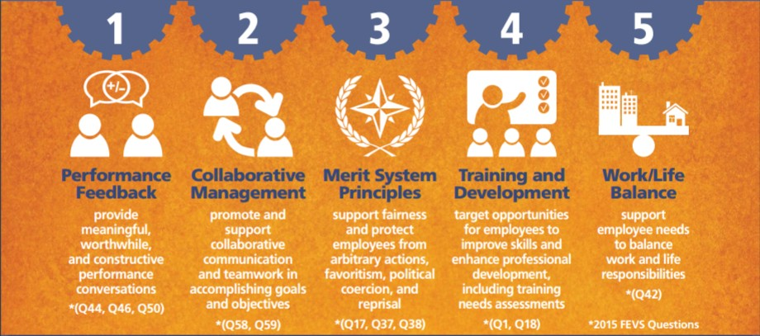
Drivers for Employee Engagement Index (EEI)
Notes:
In this project, we’ll do some research about factors affect the satisfaction of employees and focus on employee engagement. A successful agency fosters conditions essential to an engaged workforce to ensure each employee can reach his or her potential and contribute to the success of the agency. Research shows a relationship between employee engagement and performance.
Analysis of Federal Employee Viewpoint Survey (FEVS) data shows specific factors support conditions for achieving an engaged workforce.

Slide 12
Data Analysis
Gender
Age group
Supervisor status
Years of service
Education degree
Consider leaving
Agency
Notes:
In this stage, we’ll do some comparison and visualization to find out the relationship among different groups and their engagement & satisfaction.

Slide 13
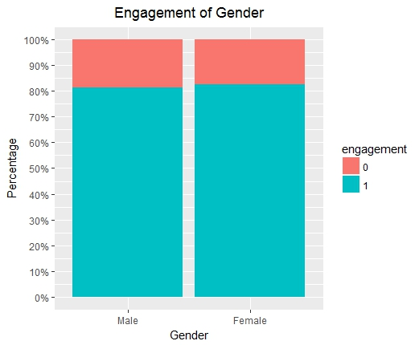
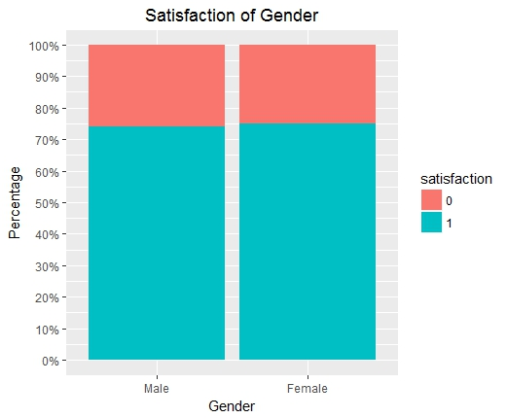
Data Analysis —— Gender
Notes:
From the plots, we can see that there’s no distinguish difference between males and females. Females are a little more engaged and satisfied than males.

Slide 14
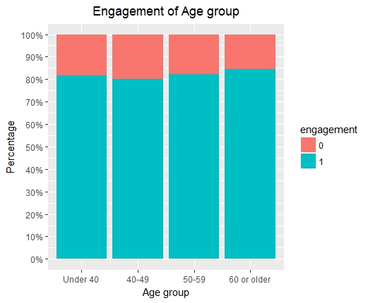
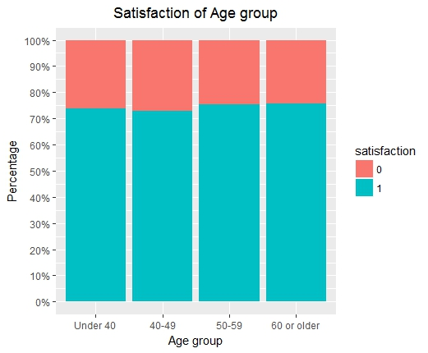
Data Analysis —— Age group
Notes:
From the plots, we can see that there are some differences among age groups. Employees age 40-49 are least engaged and satisfied while employees over 60 are most engaged and satisfied with their organizations.

Slide 15
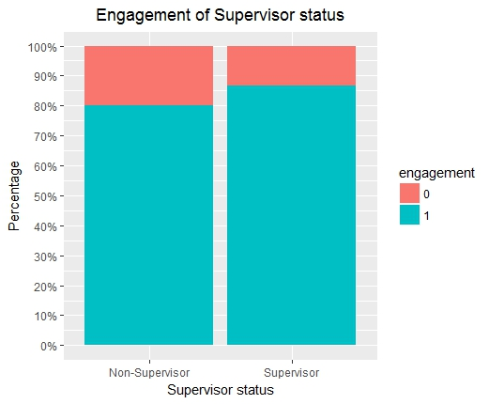
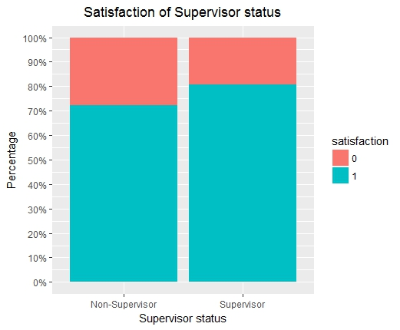
Data Analysis —— Supervisor status
Notes:
From the plots, we can see that there’s distinguish difference between supervisors and non-supervisors. Supervisors are much more engaged and satisfied than non-supervisors. The differences are 6~8%.

Slide 16
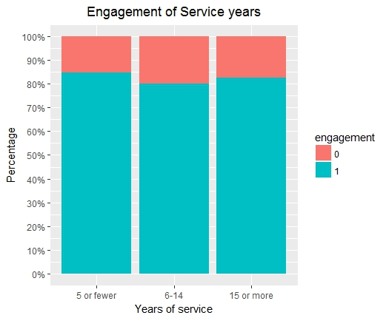
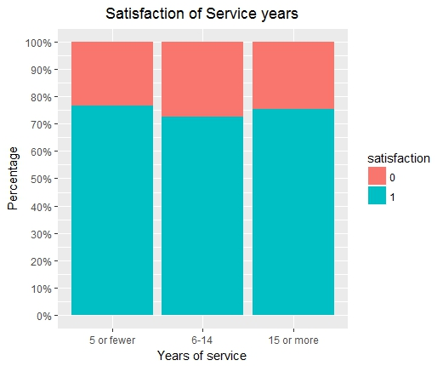
Data Analysis —— Years of service
Notes:
From the plots, we can see that there is some difference among service year groups. Employees with 6-14 years of service are much less engaged and satisfied than employees who worked fewer or more years.

Slide 17
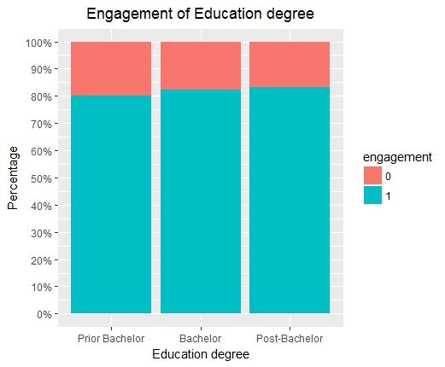
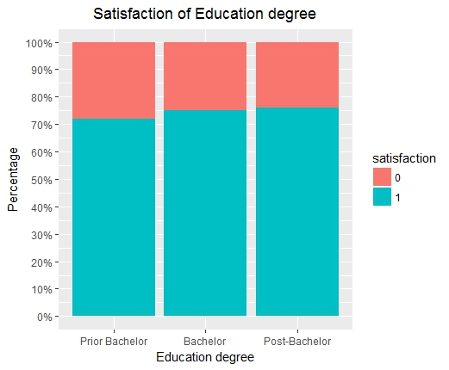
Data Analysis —— Education degree
Notes:
From the plots, we can see that there is a little difference among education degree groups. The higher the employee’ degree is, the more engaged and satisfied the employee feel. Through the difference is not distinguished.

Slide 18
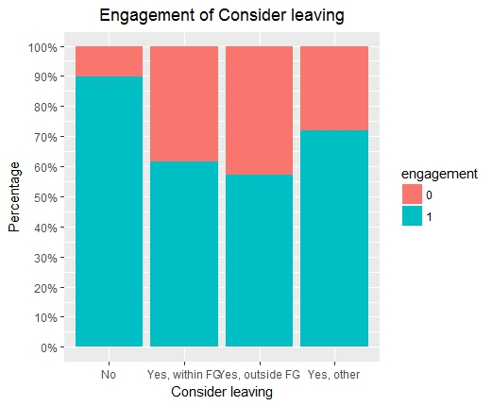
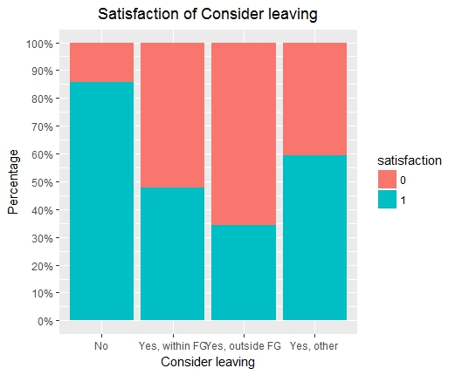
Data Analysis —— Consider leaving
Notes:
From the plots, we can see that there is big difference between employees who do and do not consider leaving. Employees don’t consider leaving are much more engaged and satisfied than employees who consider leaving, especially that consider to take another job outside the Federal Government. The difference is as big as 35~50%.

Slide 19
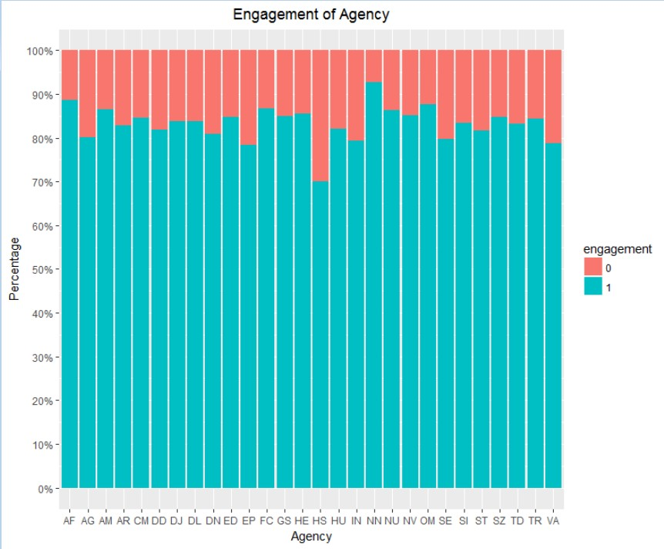
Data Analysis —— Agency engagement
Notes:
Engagement of different agencies are different. From the plot we know that HS(Department of Homeland Security) is the least engaged agency, and its engagement is about 70%. NN(National Aeronautics and Space Administration) is the most engaged agency, its engagement is about 95%. With this plot, leaders and managers of the agencies can get their agencies’ engagement and consider if they need to work on improvement.

Slide 20
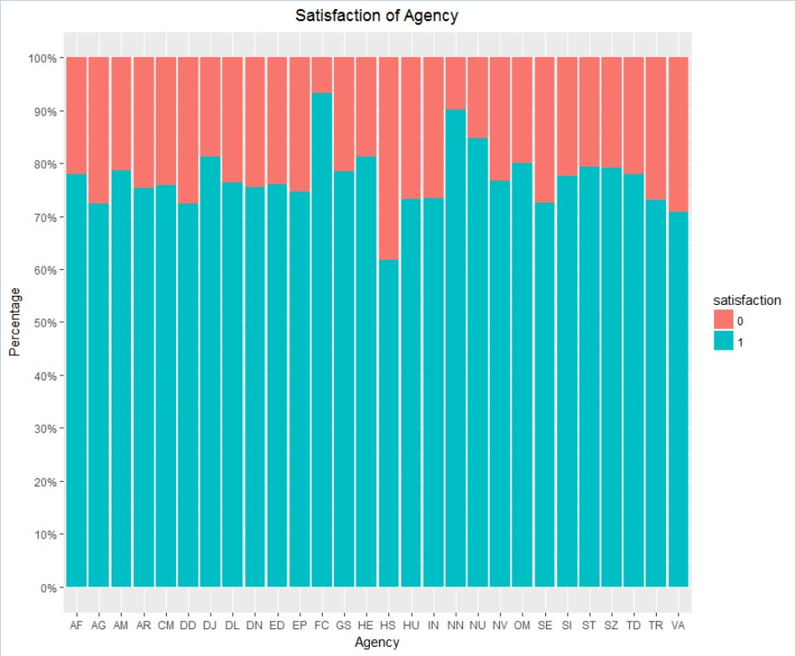
Data Analysis —— Agency satisfaction
Notes:
Satisfaction of different agencies are different. From the plot, we know that HS (Department of Homeland Security) is the least satisfied agency, and its satisfaction is about 62%. FC (Federal Communications Commission) is the most satisfied agency, its satisfaction is about 95% and NN (National Aeronautics and Space Administration) is the second satisfied agency, its satisfaction is about 90%. With this plot, leaders and managers of the agencies can get their agencies’ satisfaction and consider if they need to work to make employees more satisfied.

Slide 21
Data Modeling
Find a model to predict the engagement of every employee by their survey answers and their demographics status:
Split the dataset into two data sets, 80%(16000 rows) is training data and 20%(4000 rows) is testing data.
Build logistic regression model to predict engagement
SurveyLog <- glm(engagement~., data=surveyTrain, family="binomial")

Slide 22
Summary of the model
Call:glm(formula = engagement ~ ., family = "binomial", data = surveyTrain)
Deviance Residuals:
Min 1Q Median 3Q Max
-1.399 0.000 0.000 0.000 4.378
Coefficients: Estimate Std. Error z value Pr(>|z|)
(Intercept) -1.886e+03 9.142e+03 -0.206 0.836563
agencyAG -9.093e+00 3.652e+00 -2.490 0.012790 *
agencyAM -6.544e+01 3.301e+04 -0.002 0.998418
agencyAR -1.945e+01 1.574e+02 -0.124 0.901641
agencyCM -2.331e+00 4.131e+00 -0.564 0.572495
agencyDD -1.803e+00 3.071e+00 -0.587 0.557049
agencyDJ -1.877e+01 6.147e+02 -0.031 0.975636
agencyDL -6.568e+00 3.208e+00 -2.047 0.040616 *
agencyDN -2.760e+00 3.696e+00 -0.747 0.455190
agencyED -2.268e+01 1.575e+04 -0.001 0.998851
agencyEP -1.742e+01 9.720e+02 -0.018 0.985704
agencyFC -5.636e+02 1.477e+05 -0.004 0.996956
agencyGS -2.070e+01 1.087e+03 -0.019 0.984812
agencyHE -2.392e+00 2.812e+00 -0.851 0.394837
agencyHS -5.673e+00 3.093e+00 -1.834 0.066688 .
agencyHU -2.197e+01 1.486e+03 -0.015 0.988205
agencyIN -3.630e+00 2.852e+00 -1.273 0.203104
agencyNN -7.299e+00 4.409e+00 -1.655 0.097855 .
agencyNU 1.989e+01 2.142e+04 0.001 0.999259
agencyNV -6.199e+00 3.446e+00 -1.799 0.072048 .
agencyOM -6.136e+01 2.659e+04 -0.002 0.998159
agencySE -2.126e+01 2.413e+03 -0.009 0.992970
agencySI -6.946e-01 2.758e+00 -0.252 0.801179
agencyST -1.925e+01 1.021e+03 -0.019 0.984962
agencySZ 5.858e-01 2.771e+00 0.211 0.832587
agencyTD -4.218e+00 3.073e+00 -1.373 0.169905
agencyTR -5.256e+00 3.455e+00 -1.521 0.128173
agencyVA -2.871e+00 2.670e+00 -1.075 0.282227
Q1 -1.231e-01 5.012e-01 -0.246 0.806005
Q2 -9.551e-01 4.681e-01 -2.041 0.041283 *
Q3 4.265e+01 2.031e+02 0.210 0.833703
Q4 4.271e+01 2.032e+02 0.210 0.833474
Q6 4.285e+01 2.032e+02 0.211 0.832955
Q9 3.911e-01 5.014e-01 0.780 0.435390
Q10 -1.422e+00 5.377e-01 -2.644 0.008189 **
Q11 4.207e+01 2.032e+02 0.207 0.835928
Q12 4.315e+01 2.032e+02 0.212 0.831779
Q15 -2.440e-01 5.610e-01 -0.435 0.663605
Q16 5.425e-02 5.048e-01 0.107 0.914411
Q17 3.743e-01 4.260e-01 0.879 0.379596
Q18 -1.861e-02 4.786e-01 -0.039 0.968977
Q19 8.261e-01 4.447e-01 1.858 0.063229 .
Q22 -5.433e-01 6.085e-01 -0.893 0.371995
Q23 -6.225e-01 5.252e-01 -1.185 0.235903
Q24 1.064e+00 8.622e-01 1.234 0.217132
Q25 -7.860e-01 5.847e-01 -1.344 0.178878
Q30 5.581e-02 5.821e-01 0.096 0.923619
Q32 5.985e-01 6.829e-01 0.876 0.380837
Q34 1.222e+00 5.405e-01 2.260 0.023827 *
Q37 1.460e+00 5.536e-01 2.637 0.008363 **
Q38 -1.440e+00 5.571e-01 -2.585 0.009741 **
Q40 -2.029e+00 6.857e-01 -2.959 0.003089 **
Q42 1.146e+00 6.152e-01 1.863 0.062506 .
Q44 6.062e-01 6.451e-01 0.940 0.347351
Q45 -3.320e-01 6.372e-01 -0.521 0.602378
Q46 -5.364e-01 6.040e-01 -0.888 0.374502
Q47 4.211e+01 2.032e+02 0.207 0.835780
Q48 4.240e+01 2.031e+02 0.209 0.834655
Q49 4.044e+01 2.031e+02 0.199 0.842196
Q50 5.437e-02 5.317e-01 0.102 0.918559
Q51 4.055e+01 2.031e+02 0.200 0.841765
Q52 4.308e+01 2.031e+02 0.212 0.832061
Q53 4.149e+01 2.031e+02 0.204 0.838155

Slide 23
Summary of the model
Q54 4.060e+01 2.031e+02 0.200 0.841578
Q55 8.606e-01 5.577e-01 1.543 0.122804
Q56 4.147e+01 2.031e+02 0.204 0.838258
Q58 2.167e+00 8.753e-01 2.475 0.013309 *
Q59 -2.653e+00 7.897e-01 -3.359 0.000782 ***
Q60 4.163e+01 2.031e+02 0.205 0.837647
Q61 4.243e+01 2.032e+02 0.209 0.834547
Q69 -1.086e+00 6.067e-01 -1.790 0.073377 .
Q70 8.416e-01 4.163e-01 2.021 0.043232 *
Q71 -1.286e-02 5.902e-01 -0.022 0.982622 DSUPERSupervisor 1.415e-01 1.387e+00 0.102 0.918726
DSEXFemale -2.274e-01 1.089e+00 -0.209 0.834564 DMINORITY 2.167e+00 1.191e+00 1.819 0.068874 . DEDUCBachelor 1.313e+00 9.894e-01 1.327 0.184453 DEDUCPost-Bachelor -4.786e-01 1.295e+00 -0.370 0.711718 DFEDTEN6-14 -2.641e+00 1.414e+00 -1.867 0.061896 . DFEDTEN15 or more -1.070e+00 1.386e+00 -0.772 0.440115 DRETIREB -1.304e+00 1.496e+00 -0.872 0.383457
DDISB -2.240e+00 1.020e+00 -2.196 0.028070 * DAGEGRP40-49 3.135e-01 1.827e+00 0.172 0.863765 DAGEGRP50-59 -1.932e+00 2.010e+00 -0.961 0.336405 DAGEGRP60 or older -4.529e+00 2.899e+00 -1.562 0.118205 DMILB 8.763e+00 3.052e+00 2.871 0.004092 **
DMILC 8.841e-01 1.615e+00 0.548 0.584011
DMILD -1.131e+00 1.289e+00 -0.877 0.380401 DLEAVINGYes, within FG -2.340e+00 1.387e+00 -1.687 0.091597 . DLEAVINGYes, outside FG -7.740e-01 1.725e+00 -0.449 0.653626 DLEAVINGYes, other -1.416e+00 1.494e+00 -0.948 0.343210 satisfaction1 2.659e+00 1.410e+00 1.886 0.059362 .
---
Signif. codes: 0 ‘***’ 0.001 ‘**’ 0.01 ‘*’ 0.05 ‘.’ 0.1 ‘ ’ 1
(Dispersion parameter for binomial family taken to be 1)
Null deviance: 15148.09 on 15999 degrees of freedom
Residual deviance: 111.92 on 15908 degrees of freedom
AIC: 295.92
Number of Fisher Scoring iterations: 25

Slide 24


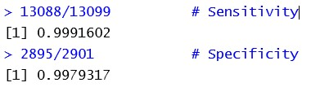

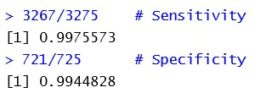

Result of the model
Predict training dataset
Confusion matrix (compare predicted vs actual)
Predict test dataset
Confusion matrix
Notes:
The result of training dataset means that we predict 99.88% ‘1’ as ‘1’ and 0.56% ‘0’ as ‘1’. This is a very precise model.
This result on testing dataset means that we predict 99.75% ‘1’ as ‘1’ and 1.19% ‘0’ as ‘1’. This is a very good result.

Slide 25
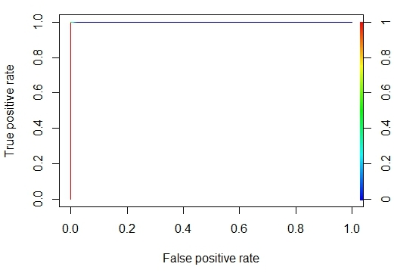
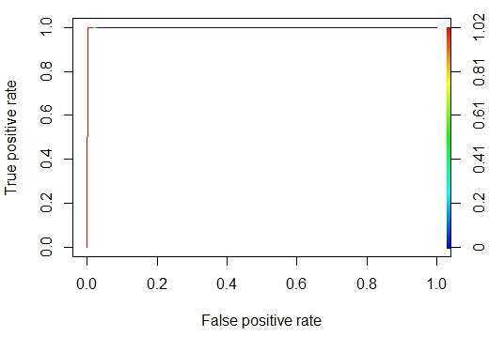
ROC curve
Training dataset ROC
Test dataset ROC
Notes:
We have applied the model in the test dataset and the predict result is very good. auc=0.9998425 means the model is very accurate.

Slide 26
Analysis Results
Aspects have significant correlation with engagement:
Job Resources: allow sufficient materials, knowledge, personnel, skills, information and work distribution to complete the job
Performance Rating: ensure employees are held accountable and performance is evaluated and rated
Merit System Principles: support fairness and protect employees from arbitrary actions, favoritism, political coercion, and reprisal
Collaborative Management: promote and support collaborative communication and teamwork in accomplishing goals and objectives
Work/Life Balance: support employee needs to balance work and life responsibilities
Global Satisfaction: employees are satisfied with their job and pay, they would recommend their organization as a good place to work
Open: Does management support diversity in all ways?
Notes:
From the summary of the model, we can get some information on which aspects affect engagement. Questions Q2, Q19, Q34, Q37, Q38, Q40, Q42, Q58, Q59, Q69, Q70 have significant correlation with engagement, those indicate the following aspects respectively:
We may call these aspects as the engagement drivers. Leaders and managers can work on these aspects to improve the engagement of their employees.
Finally, we built a very good model with 80% of the sample data to predict every employee’s engagement from their survey answers. This model turned out to be very accurate, we can use it on the large data outside sample dataset.

Slide 27

Future Work
Engagement of work units
Predict engagement of a work unit
Improve engagement of a work unit
Compare results of different years

Slide 28

Thank You!

